Slide 1
Bullying Awareness for Parents
Mallard Creek Elementary
Principal’s Coffee
March 28, 2017

Slide 2
Your School Counselors
Waynette Henry
Kindergarten, 1st, 3rd grades
waynettee.henry-wilson@cms.k12.nc.us
Robyn Faison Harris
2nd, 4th, 5th grades
robynd.faison@cms.k12.nc.us
MallardCreekCounseling.weebly.com

Slide 3
Bullying? What exactly is it?
Bullying is aggressive behavior that occurs when a child is targeted (by one or more individuals) with repeated negative actions over a period of time.
The bullying behaviors are intentional attempts to cause discomfort, or injury and include name-calling, malicious teasing, exclusion, threats, rumors, and/or physical violence.
Bullying of any kind (including physical, verbal and/or cyber-bullying) is a form of violence and should not be tolerated.

Slide 4
Recognizing and Identifying Bullying
Both boys and girls bully. Boys tend to bully more often and are more likely to experience physical bullying. Girls are more likely to experience emotional bullying and harassment.
Bullies usually pick on others out of frustration with their own lives. They target other children who appear "weaker," "different," and/or are "less popular."
Bullies are more likely to have social influence and may be overly concerned with popularity. They are most likely to have low self-esteem, be easily pressured by others, be less likely to show empathy, view violence in a positive way and may have difficulty following rules.
Some children/students may tease their peers simply to go along with the crowd.

Slide 5
Bullying vs. Normal Peer Conflict
Normal conflict
Equal power or are friends
Happens occasionally
Accidental
Not serious
Equal emotional reaction
Not seeking power
Remorse, will take responsibility
Effort to solve the problem
Bullying
Imbalance of power
Repeated negative actions
Intentional
Physical or emotional harm
Unequal emotional reaction
Seeking control/material things
No remorse-blames target
No effort to solve the problem

Slide 6
Communicating With Your Child
As a parent, it can be difficult to get your child to talk about their fears and hurts—especially when they are being bullied.
Daily talks with your child are essential. Create a safe environment by providing comfort and support.
Establish trust by actively listening, showing that their thoughts, ideas and feelings matter.
Talking about any bullying experiences you had in your childhood might help your child feel less alone.
Notes:
6-12 Robyn

Slide 7
How to start "the talk"…
Who did you sit next to at lunch today?
How was the bus ride home?
I notice that you don’t like going to school on Thursdays. What happens on that day that you don’t like?
Is there someone at school who makes you feel bad?
Who did you play with a recess today?
Tell me why you don’t like that person.
Is this the only time this has happened?
Are you looking forward to going to school tomorrow?
What exactly did the kid do/say to you?
Was there a teacher, or adult who saw what happened? What kids were there?

Slide 8
What Parents Can Do
Start early. Consistently teach children to respect others. The best way to do this is through modeling. Intervene with small acts of teasing at early ages.
Teach your child how to be assertive in conflict, not aggressive or passive. Encourage your children to express their feelings clearly, say "no" when they are uncomfortable or feel pressured and to walk away without fighting.
Speak up against bullying when you see it. Silence is acceptance.
Notes:
Teachable moments in politics, Road rage, domestic relationships, parent/child relationships.

Slide 9
What Parents Can Do (Cont' d)
Listen and support children who speak up. Telling an adult about bullying is not easy for children. Take time to listen, provide affirmation and support before taking action.
Encourage your child to take action when they see bullying behavior. Talk with your child about speaking up against the bully (when safe to do so) and informing adult staff member.
Team up. Bullying is less likely to occur when parents and teachers communicate often and parents are visible at the school.

Slide 10
Action Steps ALL parents can take to support their children with bullying
Be a good example of kindness and leadership. Your children are watching!
Don’t overreact. They will take cues from you about how to handle their situation. Calm, well-planned approaches work best.
Learn the signs (frequent loss of belongings, complaints of feeling ill, avoiding school or activities at school, etc.)

Slide 11
Action Steps ALL parents can take to support their children with bullying (Cont’d)
Create healthy anti-bullying habits early. Use teachable moments. "How do you think you would feel if that happened to you?"
Establish household rules about bullying. Monitor sibling interactions and address major concerns.
Create a partnership with essential school personnel. It takes a village to eliminate bullying, and it is the responsibility of the whole village.

Slide 12
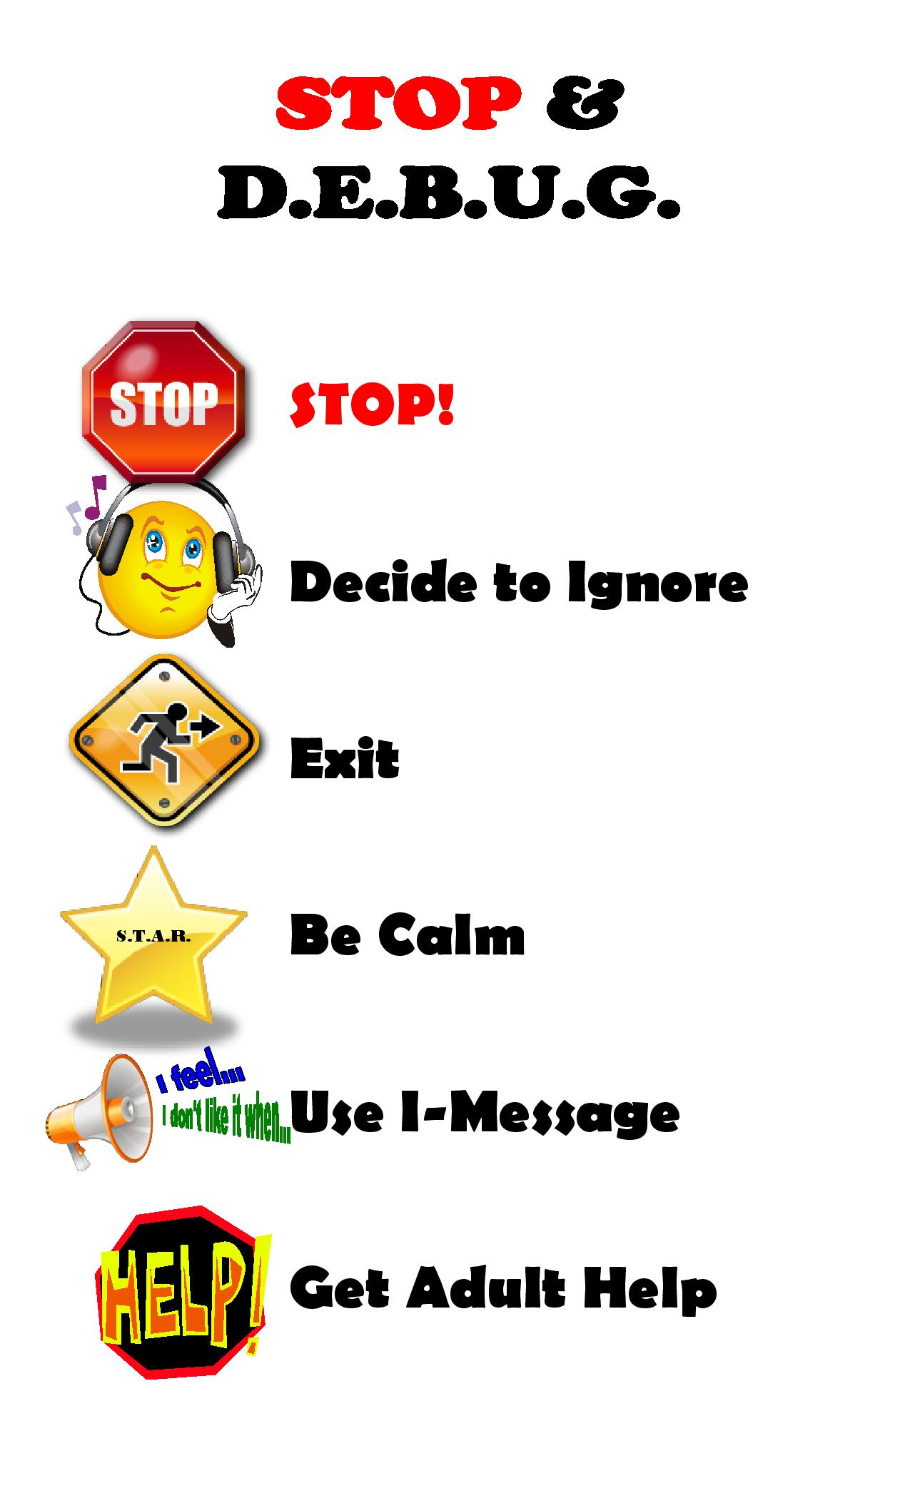
Stop & DEBUG
Assertively stand up for yourself.
Don’t give them the attention they are seeking.
Stay away and find safety.
Handle your feelings calmly. Don’t give them a reaction.
Use assertive conflict management skills. Show confidence.
When you cannot solve the problem on your own, get an adult to intervene.
Notes:
Know when to use what skills

Slide 13
How to help if your child is bullying others
Have open and honest communication with your child.
Be committed to helping your child find healthy ways to resolve conflict.
Talk with your child’s teachers, staff and counselors.
Monitor your child’s behavior at home closely.
Model respectful interactions with others inside and outside of home.
Spend quality time with your child.
Be realistic and patient. Change doesn't happen overnight.
Don’t be afraid to ask for help.

Slide 14
Cyberbullying? What’s that?
The use of technology to harass, threaten, embarrass, or target another person.

Slide 15
Preventing Cyberbullying
Limit access to technology. Give time limits and restrictions on certain sites/apps. Use filtering and blocking software as necessary.
Know your child’s online world. Learn the social media sites and what your child is connected to. Monitor his or her online usage.
Keep the computer in a common area. Remove their cell phones/tables/iPods from their room at bedtime.
Notes:
When adults do this, it is considered cyber-harassment– a crime with legal consequences, even jail time.

Slide 16
If Cyberbullying happens
Talk regularly and specifically with your child about online issues. Let them know they can come to you for help if anything is inappropriate, upsetting or dangerous.
Don’t threaten to take away their technology if they come to you with a problem. This only encourages kids to be more secretive.
Don’t underreact, but be supportive. The emotional pain of being bullied is very real and can have long lasting effects.

Slide 17
If Cyberbullying happens (cont' d)
Block the bully. Teach your child not to respond to threats or negative comments online.
Don’t be an accomplice by forwarding any of the messages to other kids.
Do not delete the messages. Instead print out all the messages, including the email addresses or online screen names of the cyberbully. These can be used as proof of cyberbullying.
Report concerns of cyberbullying to the Dean of Students and/or school administration.
Notes:
17-18 Robyn

Slide 18
Resources
https://www.stopbullying.gov/what-you-can-do/parents/index.html
http://kidshealth.org/en/parents/bullies.html
http://www.nmha.org/sites/default/files/BACK%20TO%20SCHOOL%202014%20-%20Bullying%20Tips%20for%20Parents.pdf
http://www.mentalhealthamerica.net/bullying-tips-parents

